Slide 1
PROBLEM SOLVING AND COMPUTER PROGRAMMING
Lecture 05:
STRINGS

Slide 2
Strings
String is a group of characters stored in a character array.
String constant is a character array terminated by ‘\0’(null).
The representation of a char (e.g., ‘Q’) and a string (e.g., “Q”) is essentially different.
\0 will be placed by compiler automatically
h | e | l | l | 0 | \0

Slide 3
Character vs String
A string constant is a sequence of characters enclosed in double quotes.
For example, the character string:
char s1[2]="a"; //Takes two bytes of storage.
s1:
On the other hand, the character, in single quotes:
char s2= `a`; //Takes only one byte of storage.
s2:
a | \0
a

Slide 4
C++ provides following two types of string representations:
The C-style character string
The string class type introduced with Standard C++

Slide 5
C-style character string
The C-style character string originated within the C language and continues to be supported within C++. This string is actually a one-dimensional array of characters which is terminated by a null character '\0'.
Example:
char name[ ] = { ‘H’, ‘E’, ‘L’, ‘L’, ‘O’, ‘\0’ };
char s[256];
char t[] = "This is an initialized string!";
char *u = "This is another string!";
Compiler automatically inserts null character at the end.

Slide 6
#include <iostream>
using namespace std;
int main ()
{
char greeting[6] = {'H', 'e', 'l', 'l', 'o', '\0'};
cout << "Greeting message: ";
cout << greeting << endl;
return 0;
}

Slide 7
String Class in C++
#include <iostream>
#include <string>
using namespace std;
int main ()
{
string str1 = "Hello";
string str2 = "World";
string str3;
int len ;
str3 = str1;
cout << "str3 : " << str3 << endl;
str3 = str1 + str2;
cout << "str1 + str2 : " << str3 << endl;
len = str3.size();
cout << "str3.size() : " << len << endl;
return 0;
}

Slide 8
Taking Input
To read a word
char ch[100];
cin>>ch
To read a line of text
cin.get(str, 100);
string using string data type
string str;
getline(cin, str);
gets()
char str[100];
gets(str);

Slide 9
Displaying Strings
// Without knowing the
// length of string
main( )
{
char name[] =“NITWarangal”;
int i=0;
while(name[i] != ‘\0’)
{
cout<<name[i];
i++;
}
}
// Using pointers
main( )
{
char name[ ] =“NITWarangal”;
char *ptr;
ptr = name;
while( *ptr != ‘\0’)
{
cout<< *ptr;
ptr ++;
}
}
main( )
{ char name[ ] =“NITWarangal”;
int i=0;
while(i<=7)
{
cout<<name[i];
i++;
}
}
But we must know the size of string.

Slide 10
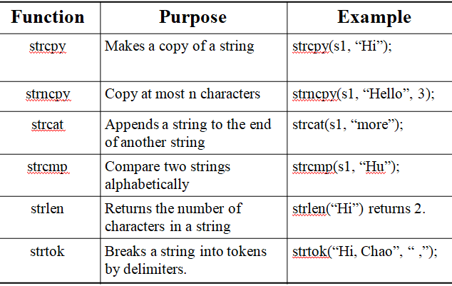
String Handling Functions

Slide 11
strlen()
#include <cstring>
#include <iostream>
using namespace std;
int main()
{
char str1[] = "This a string";
int len1 = strlen(str1);
cout << "Length of str1 = " << len1 << endl;
return 0;
}

Slide 12
strcpy()
#include <cstring>
#include <iostream>
using namespace std;
int main()
{
char s1[] = "Hello Programmers.";
char s2[20];
strcpy(s2,s1);
cout << s2;
return 0;
}

Slide 13
strncpy()
#include <cstring>
#include <iostream>
using namespace std;
int main()
{
char s1[] = "This is First Year";
char s2[40];
strncpy(s2,s1,10);
cout<<s1<<endl;
cout<<s2<<endl;
return 0;
}

Slide 14
strcat()
#include <cstring>
#include <iostream>
using namespace std;
int main()
{
char s1[50] = "This if F section";
char s2[50] = " first year";
strcat(s1, s2);
cout << s1 ;
return 0;
}

Slide 15
strcmp()
#include <cstring>
#include <iostream>
using namespace std;
int main() {
char s1[] = "ADC"; char s2[]= "ABC";
if(strcmp(s1,s2) > 0)
cout << s2 << "is greater than " << s1 << endl;
else if (strcmp(s1,s2) < 0)
cout << s2 << " is less than " << s1 << endl;
else
cout << s1 << " and " << s2 << " are same" << endl;
return 0;
}

Slide 16
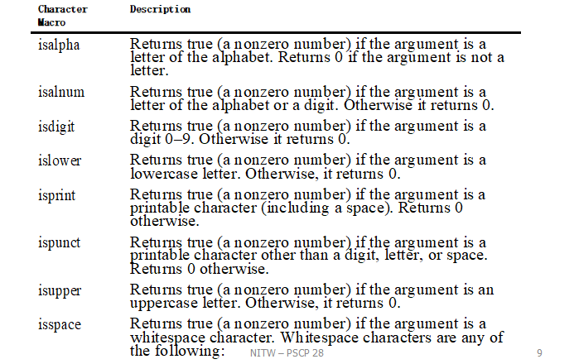
Character functions in c (ctype.h)

Slide 17
#include <ctype.h>
#include <iostream>
#include <stdlib.h>
using namespace std;
int main(){
char str[] = "12abc12";
int alphabet = 0, number = 0, i;
for (i = 0; str[i] != '\0'; i++)
{
if (isalpha(str[i]) != 0)// check for alphabets
alphabet++;
else if (isdigit(str[i]) != 0) // check for decimal digits
number++;
}
cout<<"Alphabetic_letters ="<<alphabet<<endl;
cout<<"Decimal_digits="<<number<<endl;
return 0;
}

Slide 18
Conversions Between Strings Numbers
The <stdlib.h> defines some basic functions for conversion from strings to numbers:
atoi(“123”) converts a string to an integer.
atol(“123”) converts a string to a long integer.
atof(“12.3”) converts a string to a float.

